Slide 1
Problem Identification
Big Mountain Resort wants to raise revenue and is looking to either raise ticket prices or modify it’s features or a combination on both.

Slide 2
Recommendation and key findings
The model suggested a price based on the key features to be $95.87 with a $10.39 error margin making the lowest increase to be $85.48 per ticket up from $81.00
Closing down 1 run will cut costs and not have an affect on ticket price
Adding 1 run & increasing the vertical drop by 150 feet would make the ticket price more valuable by $1.99

Slide 3
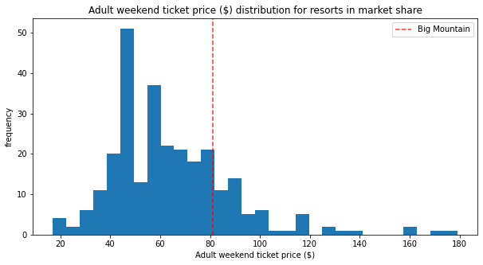

Slide 4
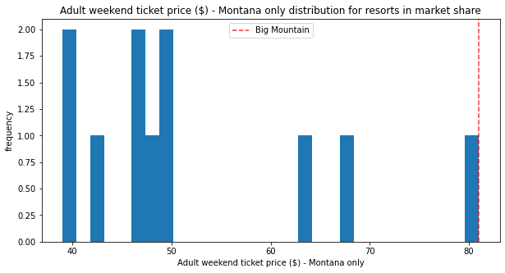

Slide 5
Summary
Even though Big Mountain Resort is on the high price end for Montana considering it features compared across the country Big Mountain Resort should raise the ticket price and consider adding to the features to further increase revenue.

